Slide 1
Database
API
UI Architecture
and Customer Delight
Josh Harrison, OTX Winc Wranglers

Slide 2
DISCLAIMER
This IS NOT a demo to help prove or support the value of accessibility.

Slide 3
DISCLAIMER
This IS NOT a demo to help prove or support the value of accessibility.
This IS a demo to prove that UI architecture is as important as DB and API architecture.

Slide 4
DISCLAIMER
This IS NOT a demo to help prove or support the value of accessibility.
This IS a demo to prove that UI architecture is as important as DB and API architecture. We just used accessibility to prove it.

Slide 5
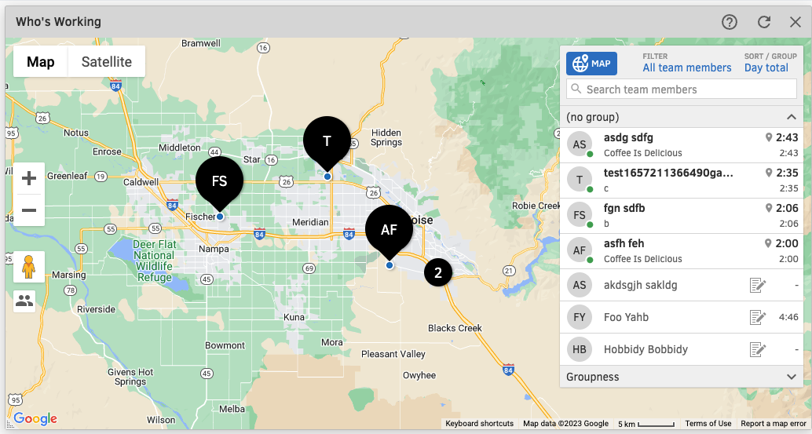
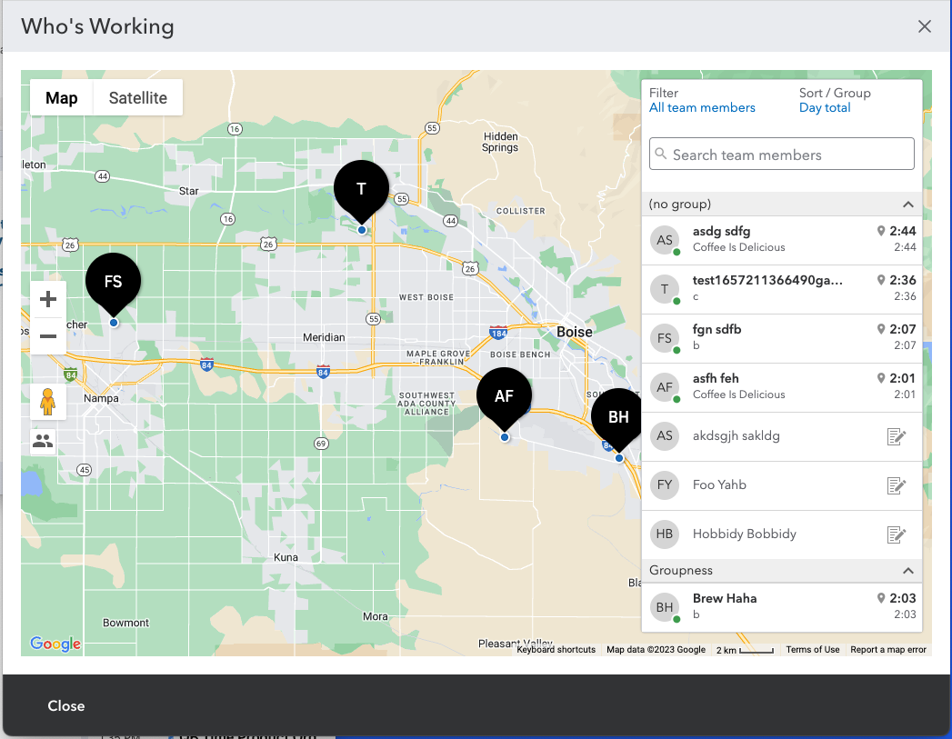

Slide 6
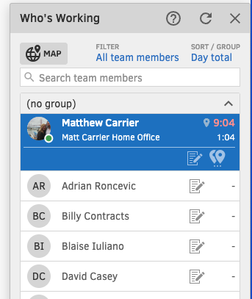

Slide 7
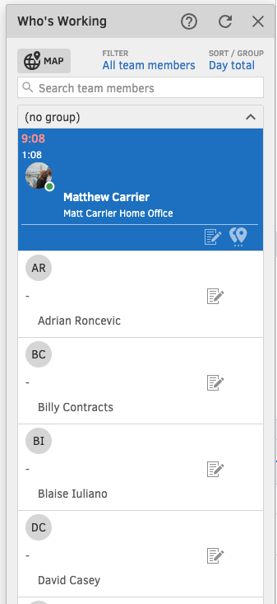

Slide 8

Brandon: “There’s no sem[antics], there’s no information to tell me what I’m seeing here.”
Brandon: “I just, kind of, can guess.”
Ted: “That could easily be an unordered list…”
Brandon: “It should be a table…”

Slide 9
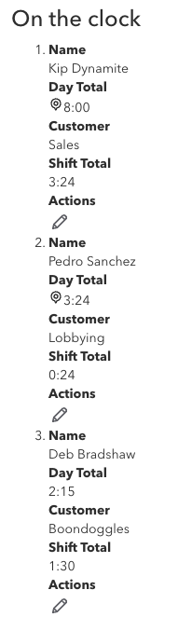

Slide 10
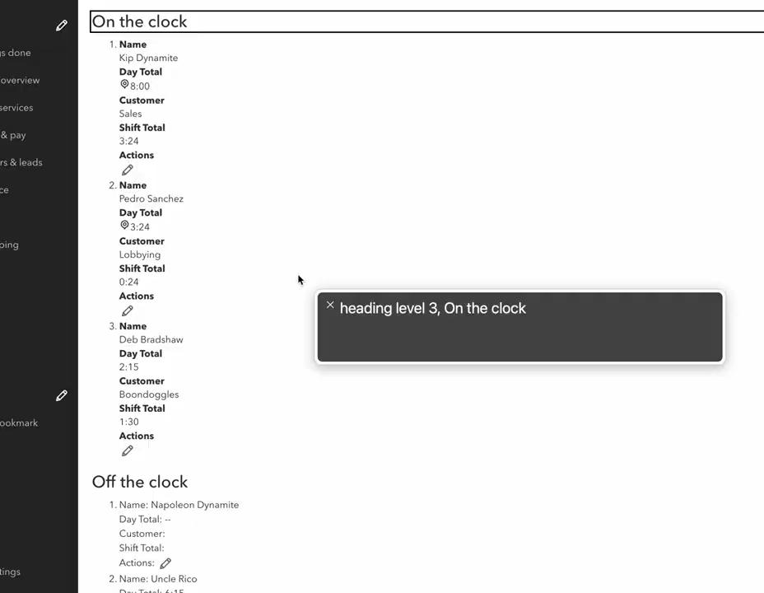

Slide 11
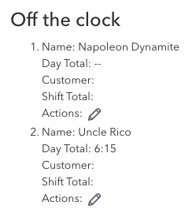

Slide 12
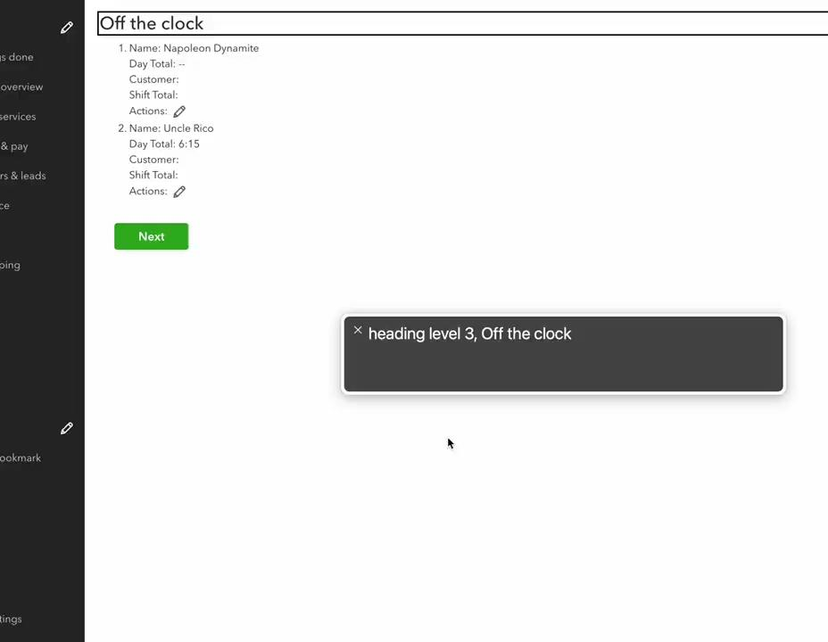

Slide 13
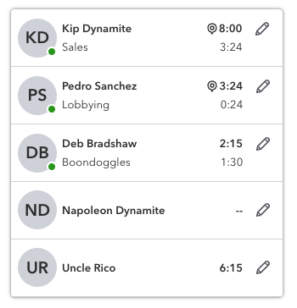

Slide 14
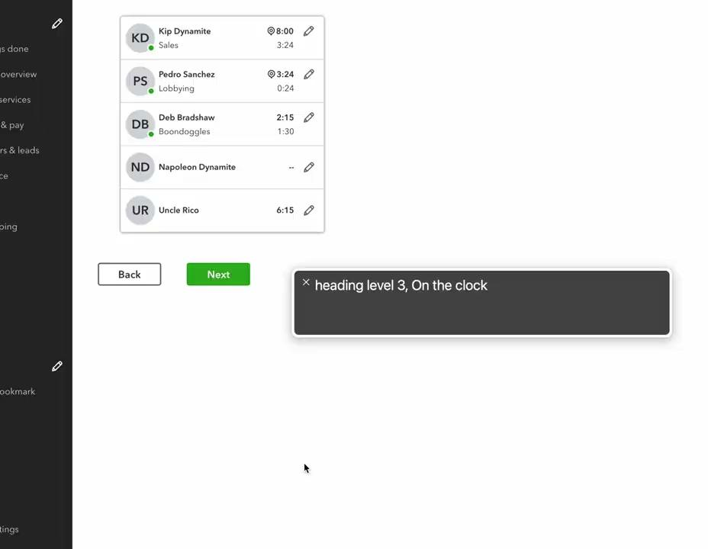

Slide 15
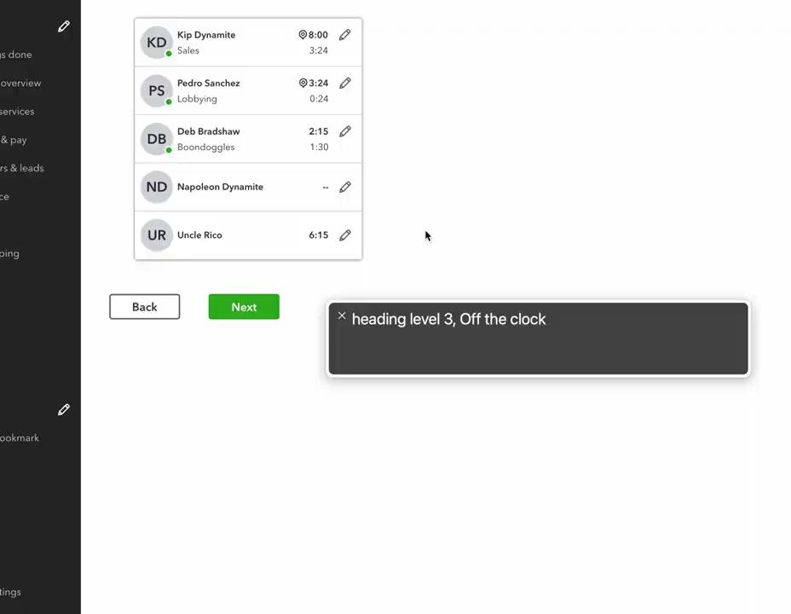

Slide 16
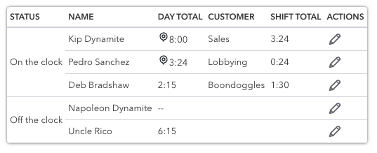

Slide 17
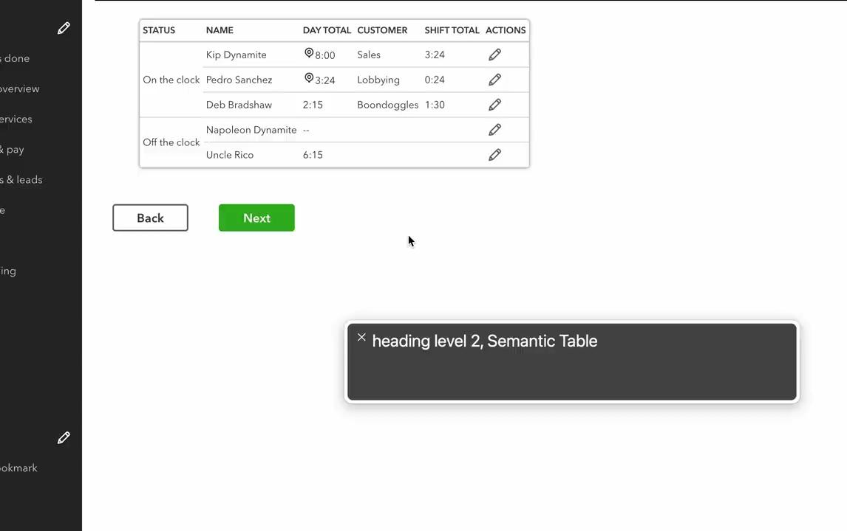

Slide 18
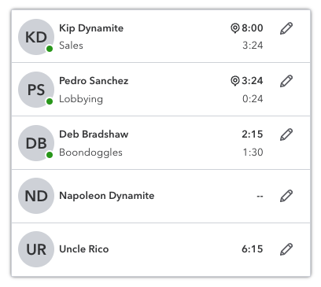

Slide 19
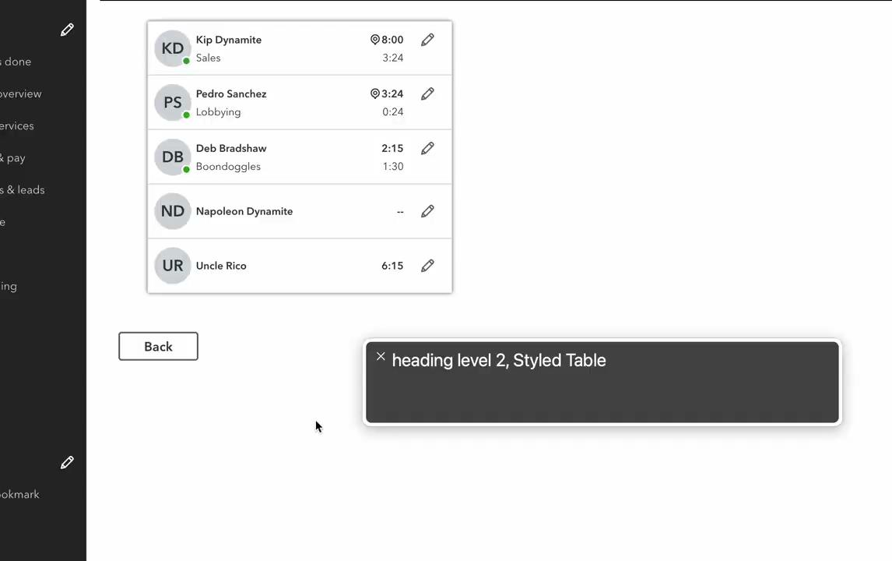

Slide 20
Lessons Learned
Visually delightful ≠ accessible

Slide 21
Lessons Learned
Visually delightful ≠ accessible

Slide 22
Lessons Learned
Visually delightful ≠ accessible
Accessible ≠ delightful experience
Building to spec ≠ delightful experience

Slide 23
Lessons Learned
Visually delightful ≠ accessible
Accessible ≠ delightful experience
Building to spec ≠ delightful experience

Slide 24
Forward-Thinking

Slide 25

Forward-Thinking
UX
Dev

Slide 26
Forward-Thinking
X
UX
Dev

Slide 27
Forward-Thinking
UI Architecture between Design and Dev
Proof-of-Concepts between Design and Dev
UI Coaching between Design and Dev
✔
UX
Dev

